Slide 1
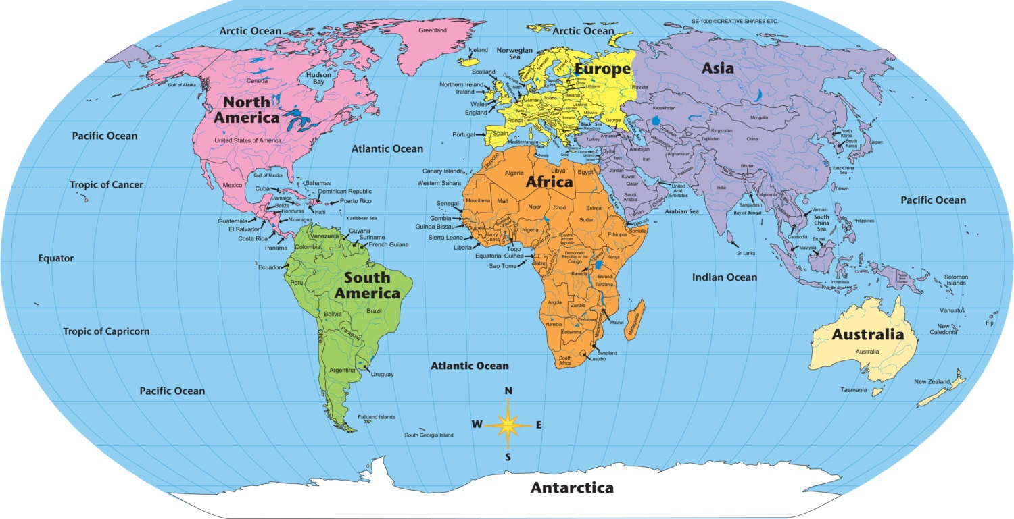
The Earth formed 4.6 billion years ago. Right after Earth’s formation, do you think the continents looked like this?

Slide 2
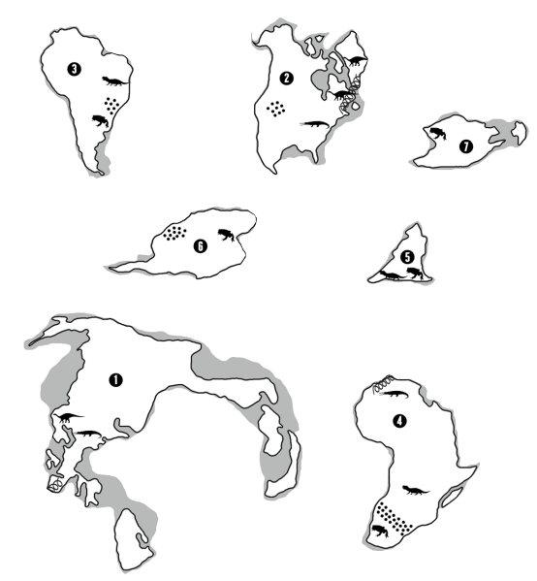

Lab: Continental Drift Do Now: 5 minutes
With your lab partner, complete the following:
Cut out each of the landforms.
Flip each landform over on your desk, so that the side facing up doesn’t have any writing on it.
Move the landforms together so that they fit together like puzzle pieces.

Slide 3

Discuss: 30 seconds
What would have made putting the landforms together easier?

Slide 4
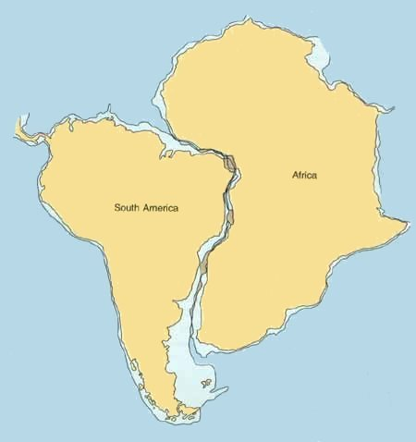
We need more evidence!

Slide 5
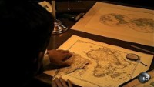
This is where the theory of continental drift started
– Alfred Wegener, 1911

Slide 6
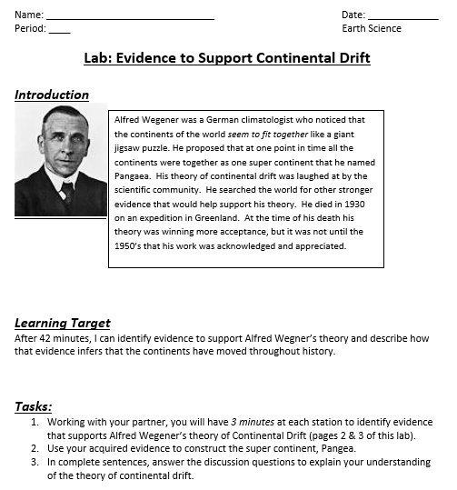

Slide 7
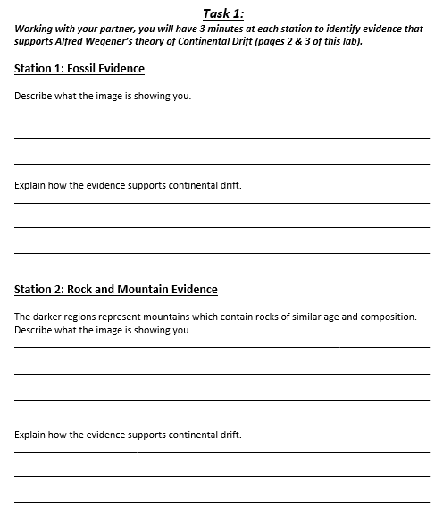
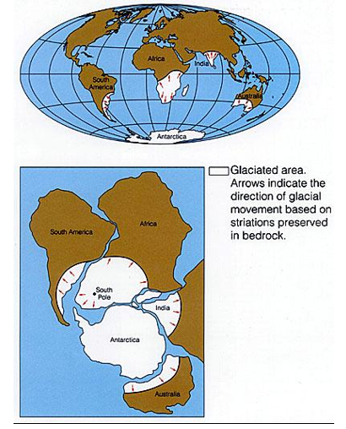
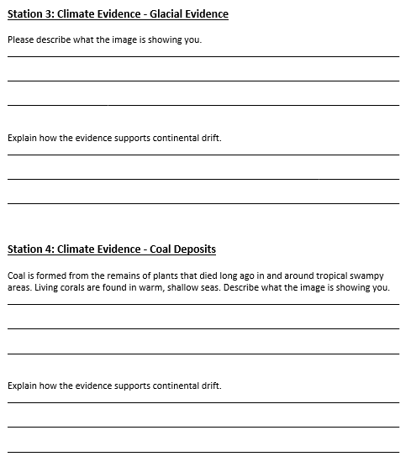
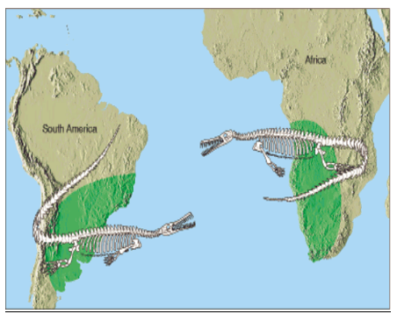
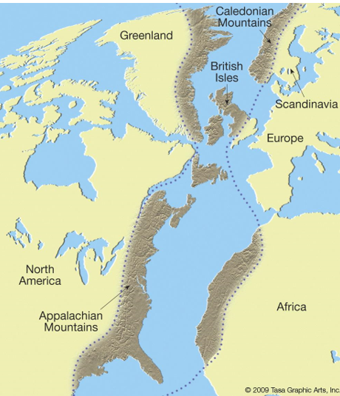
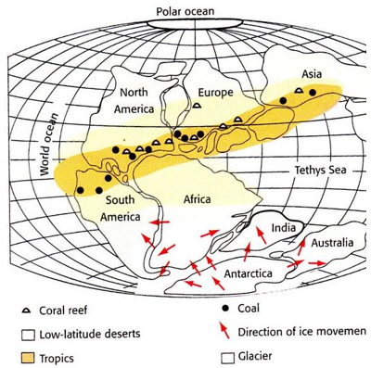

Slide 8
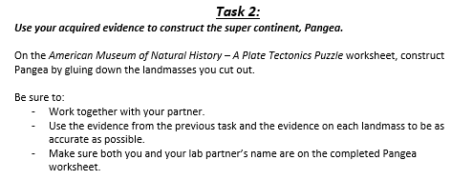
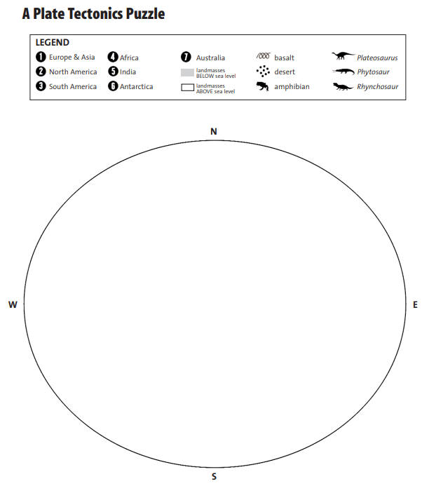


Slide 9
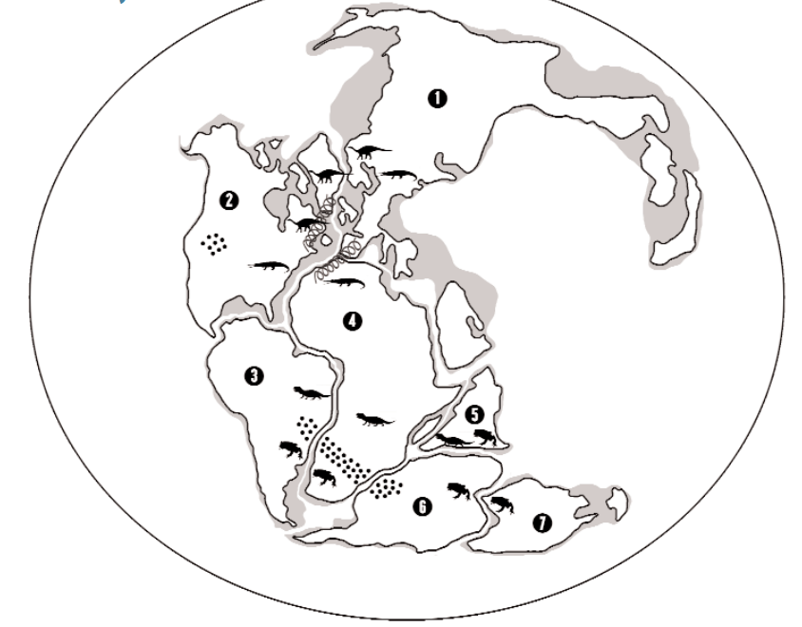
KEY

Slide 10
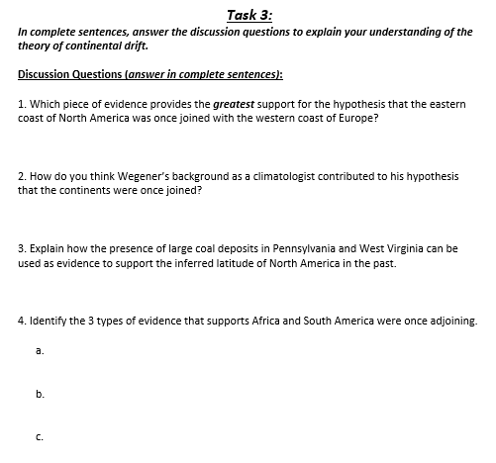
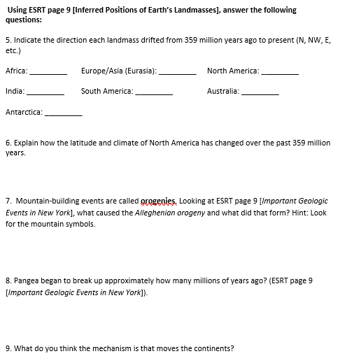


Slide 11
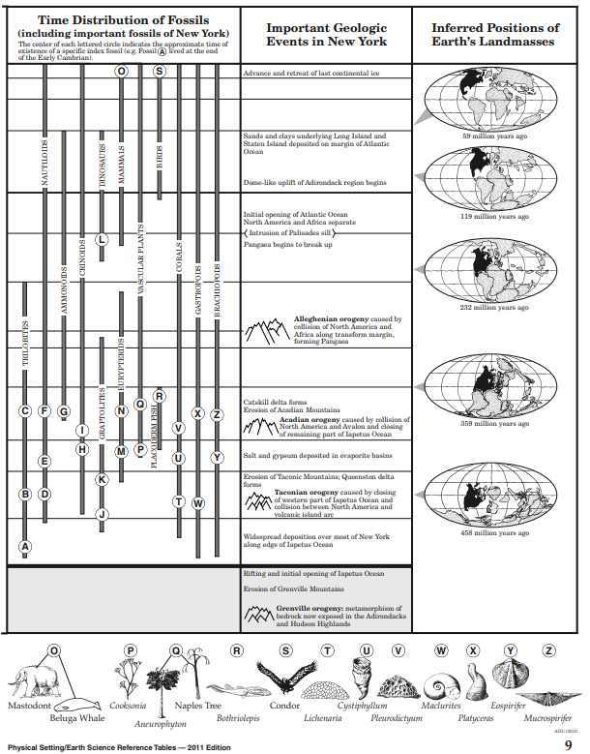

Slide 12
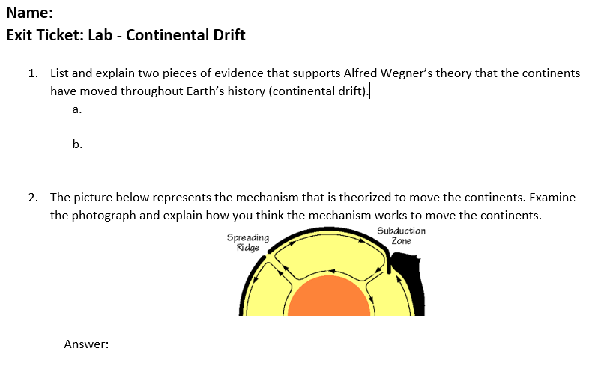
Complete the Exit Ticket

